Slide 1
CSE 428 Semantic Web Topics XML
Jeff Heflin
Lehigh University

Slide 2
XML Example
<?xml version="1.0" ?> <cd sernum="99999">
<!-- IMHO, a truly great CD --> <title>Yankee Hotel Foxtrot</title> <artist>Wilco</artist> <cover photo="/covers/yht.gif" /> <track no="4">War on War</track> </cd>

Slide 3
XML DTD
<!ELEMENT cd (title, artist, track*, cover?) > <!ATTLIST cd sernum CDATA #REQUIRED> <!ELEMENT title (#PCDATA) > <!ELEMENT artist (#PCDATA) > <!ELEMENT cover EMPTY> <!ATTLIST cover photo CDATA #REQUIRED>

Slide 4
XML Schema Example
<xsd:schema xmlns:xsd="http://www.w3.org//2000/10/XMLSchema"> <xsd:element name="movie"> <xsd:complexType> <!-- b/c it has children --> <xsd:sequence> <xsd:element name="title" type="xsd:string" /> <xsd:element name="director"> <xsd:complexType> <xsd:sequence> <xsd:element name="title" type="xsd:string" minOccurs="0" /> <xsd:element name="fname" type="xsd:string" /> <xsd:element name="lname" type="xsd:string" /> </xsd:sequence> </xsd:complexType> </xsd:element> <xsd:element name="actor" minOccurs="0" maxOcurs="unbounded" > ... </xsd:element> </xsd:sequence> <xsd:attribute name="gross" type="xsd:decimal" /> </xsd:complexType> </xsd:element>
</xsd:schema>

Slide 5
Name Conflicts?
Elements about people: title, fname, lname
Elements about movies: title, director, actor
<movie> <title>Star Wars</title> <director> <fname>George</fname> <lname>Lucas</lname> </director> <actor> <title>Sir</title> <fname>Alec</fname> <lname>Guiness</lname> </actor> </movie>

Slide 6
XML Namespaces
<m:movie xmlns:m="http://www.hollywood.org/movies" xmlns:p="http://www.standards.org/people"> <m:title>Star Wars</m:title> <m:director> <p:fname>George</p:fname> <p:lname>Lucas</p:lname> </m:director> <m:actor> <p:title>Sir</p:title> <p:fname>Alec</p:fname> <p:lname>Guiness</p:lname> </m:actor> </m:movie>

Slide 7
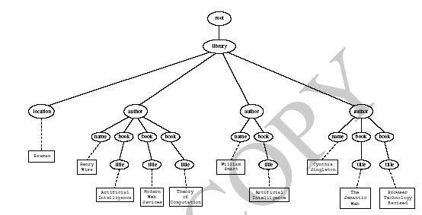
XML Tree Representation
From Fig. 2.2, p. 49

Slide 8
XSLT Example
An XSLT Stylesheet
Original Document
<xsl:stylesheet version=“1.0” xmlns:xsl=“http://www.w3.org/1999/…”>
<xsl:template match="/"> <html> <body> <xsl:apply-templates select="book“ /> </body> </html> <xsl:template>
<xsl:template match="book"> <p> <b><xsl:value-of select="title" /></b> by <xsl:value-of select="author“ /> . <xsl:value-of select="published“ /> </p> </xsl:template> </xsl:stylesheet>
<book> <title>The Fellowship of the Ring </title> <author>J.R.R. Tolkien</author> <published>1963</published> </book>
Transformed Document
<html> <body> <p> <b>The Fellowship of the Ring</b> by J.R.R. Tolkien. 1963 </p> </body>
</html>

