Slide 1
Ch. 5 – Adversarial Search
Supplemental slides for CSE 327
Prof. Jeff Heflin

Slide 2
Two-player Zero Sum Games
S₀ – initial state
Player(s) – whose turn it is in state s
Action(s) – legal moves in state s
Result(s,a) – transition model
Terminal-Test(s) – is game over?
Utility(s,p) – utility of p in terminal state s

Slide 3
Tic-Tac-Toe Transition Model
X | X | O
O |  | X
O to top-left
O to top-center
O to top-right
O to bottom-center
O
X | X | O
O |  | X
 | O
X | X | O
O |  | X
 |  | O
X | X | O
O |  | X
X | X | O
O | O | X

Slide 4
Minimax Algorithm
function Minimax-Decision(state) returns an action return arg max_{a ∈ ACTIONS(s)} Min-Value(Result(state,a))
function Max-Value(state) returns a utility value if Terminal-Test(state) then return Utility(state) v ← -∞ for each a in Actions(state) do v ← Max(v, Min-Value(Result (s,a))) return v
function Min-Value(state) returns a utility value if Terminal-Test(state) then return Utility(state) v ← +∞ for each a in Actions(state) do v ← Min(v, Max-Value(Result (s,a))) return v
From Figure 5.3, p. 166

Slide 5
Utility-Based Agent
sensors
State
What the world is like now
How the world evolves
What my actions do
What it will be like if I do action A
Environment
Utility
How happy will I be in such a state
What action I should do now
Agent
actuators

Slide 6
Minimax with Cutoff Limit
function Minimax-Decision(state) returns an action return arg max_{a ∈ ActionS(s)} Min-Value(Result(state,a),0)
function Max-Value(state,depth) returns a utility value if Cutoff-Test(state,depth) then return Eval(state) v ← -∞ for each a in Actions(state) do v ← Max(v, Min-Value(Result(s,a)), depth+1) return v
function Min-Value(state,depth) returns a utility value if Cutoff-Test(state,depth) then return Eval(state) v ← +∞ for each a in Actions(state) do v ← Min(v, Max-Value(Result(s,a)), depth+1) return v

Slide 7
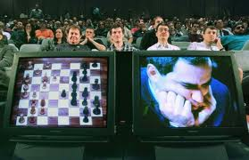
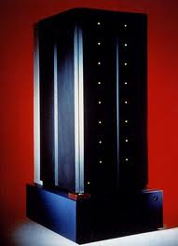
Deep Blue
1997: Beat chess world champion Gary Kasparov in a 6 game match (3.5 to 2.5)
Algorithm
Minimax algorithm using alpha-beta pruning
Book moves (4000 standard openings and all end games with 5 pieces)
Selective extensions (searches deeper from critical positions)
Hardware
IBM SP2 supercomputer with 32 special-purpose chess-playing computer chips
Could search 100 million to 300 million positions per second
Normally search depth of 14 plies, but up to 40 plies with selective extensions

