Slide 1
Artificial Intelligence: Theory and Practice
Ch. 3. Search
Slides from Russell, Abbeel, Heflin
Changjoo Nam
Postdoctoral Fellow
The Robotics Institute
Carnegie Mellon University
Feb 6, 2018 | Lehigh University
Image credit: Charles Taylor

Slide 2
Overview
Uninformed Search
Informed Search
Summary
AlphaGo Movie (2017)

Slide 3
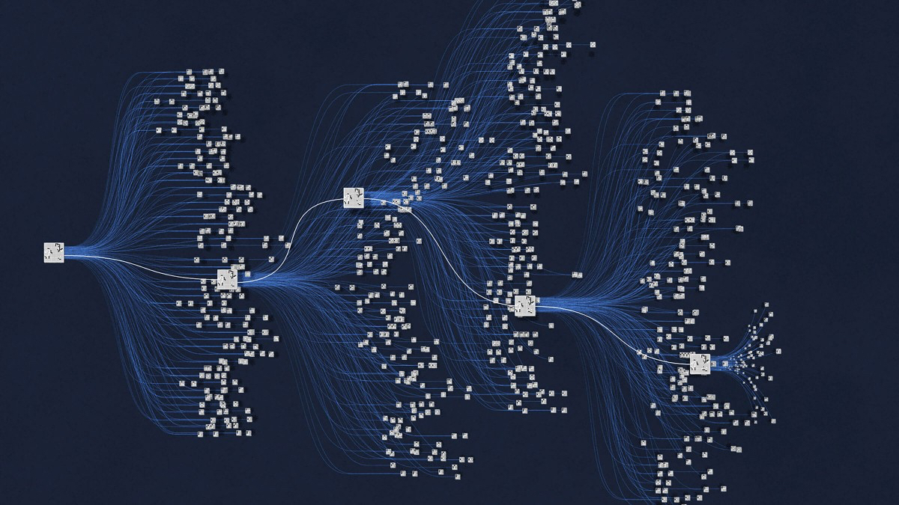
Overview
Uninformed Search
Informed Search
Summary
The Search Space in Go Game
The number of possible configurations of the board
$$>$$
The number of atoms in the universe (~10⁸⁰)

Slide 4
Overview
Uninformed Search
Informed Search
Summary
Outline
Uninformed Search
Review: Depth-first search
Breadth-first search
Uniform-cost search
Informed Search
Greedy best-first search
A* search

Slide 5
Overview
Uninformed Search
Informed Search
Summary
Review: Overview
Uninformed search
No additional information about states
A goal state vs. non-goal states
cf) Informed search: more promising non-goal states

Slide 6
Overview
Uninformed Search
Informed Search
Summary
Review: Depth-First Search (DFS)
Strategy: expands deepest node first
Process some left prefix of the tree
LIFO queue (stack): put successors at front
1
A
not generated
2
7
B
C
on frontier
in memory
3
6
8
9
deleted
D
E
F
G
4
5
H
I

Slide 7
Overview
Uninformed Search
Informed Search
Summary
Review: Depth-First Search (DFS)
Strategy: expands deepest node first
Process some left prefix of the tree
LIFO queue (stack): put successors at front
1
A
H
I
D
not generated
2
7
F
E
B
C
B
on frontier
A
G
C
in memory
Stack
3
6
8
9
deleted
D
E
F
G
4
5
H
I

Slide 8
Overview
Uninformed Search
Informed Search
Summary
Review: Depth-First Search (DFS)
Complete?: No (infinite loops)
Optimal?: No (“leftmost” solution)
Time complexity: $O(b^{m})$
Space complexity: $O(bm)$ (not bad!)
a
S
G
b
$1$ node
$$b$$
...
$b$ nodes
$b^{2}$ nodes
$m$ tiers
$b^{m}$ nodes

Slide 9
Overview
Uninformed Search
Informed Search
Summary
Breadth-First Search (BFS)
Strategy: expands shallowest node first
Process all nodes above the shallowest solution
FIFO queue: put successors at end
1
A
not generated
2
3
B
C
on frontier
in memory
4
5
6
7
D
E
F
G
deleted
8
9
H
I

Slide 10
Overview
Uninformed Search
Informed Search
Summary
Breadth-First Search (BFS)
Strategy: expands shallowest node first
Process all nodes above the shallowest solution
FIFO queue: put successors at end
A
B
1
C
A
Queue
D
not generated
2
3
E
B
C
F
on frontier
G
in memory
H
4
5
6
7
D
E
F
G
I
deleted
8
9
H
I

Slide 11
Overview
Uninformed Search
Informed Search
Summary
Breadth-First Search (BFS)
Complete?: Yes (if $b$ is finite)
Optimal?: Yes (if identical step costs)
Time complexity: $O(b^{d})$
Space complexity: $O(b^{d})$
$1$ node
A
$$b$$
5
...
$b$ nodes
1
$d$ tiers
B
G
$b^{d}$ nodes
1
1
$b^{m}$ nodes
G
C

Slide 12
Overview
Uninformed Search
Informed Search
Summary
Quiz
BFS
DFS
Credit: muneems/YouTube

Slide 13
Overview
Uninformed Search
Informed Search
Summary
Uniform-Cost Search
Strategy: expands cheapest node first
Process all nodes with cost less than cheapest solution
Priority queue: ordered by path (cumulative) cost $g(n)$
State space
Search tree
I
10
G
1
4
B
5
I
$$g(I)=0$$
3
C
2
not generated
B
$$g(B)=4$$
G
$$g(G)=10$$
on frontier
in memory
3
4
C
$$g(C)=7$$
G
$$g(G)=9$$
deleted

Slide 14
Overview
Uninformed Search
Informed Search
Summary
Uniform-Cost Search
Strategy: expands cheapest node first
Process all nodes with cost less than cheapest solution
Priority queue: ordered by path (cumulative) cost $g(n)$
$$g(n)$$
State space
I 0
Search tree
10
Priority queue
B 4
I
G
C 7
1
4
B
I
$$g(I)=0$$
G 9
5
G 10
3
C
2
not generated
B
$$g(B)=4$$
G
$$g(G)=10$$
on frontier
in memory
3
4
C
$$g(C)=7$$
G
$$g(G)=9$$
deleted

Slide 15
Overview
Uninformed Search
Informed Search
Summary
Uniform-Cost Search
Complete?: Yes (if step cost $≥ε$)
Optimal?: Yes
Time complexity: $O(b^{⌊\frac{C^{∗}}{ε}⌋})$
Space complexity: $O(b^{⌊\frac{C^{∗}}{ε}⌋})$
Finds an optimal path to the next node
Path cost never decreases as nodes are added
A
$$b$$
...
4
3
$C^{∗}/ε$ “tiers”
$$g(B)=4$$
$$g(G)=3$$
B
G
-2
1
$$g(G)=2$$
G
C

Slide 16
Overview
Uninformed Search
Informed Search
Summary
Summary
 | Depth-first | Breadth-first | Uniform-cost
Queuing | At front | At end | By path cost
Complete? | No (infinite loops) | Yes (if $b$ is finite) | Yes (if step cost $≥ε$)
Optimal? | No (“leftmost”) | Yes (if identical step costs) | Yes
Time | $$O(b^{m})$$ | $$O(b^{d})$$ | $$O(b^{⌊\frac{C^{∗}}{ε}⌋})$$
Space | $$O(bm)$$ | $$O(b^{d})$$ | $$O(b^{⌊\frac{C^{∗}}{ε}⌋})$$

Slide 17
Overview
Uninformed Search
Informed Search
Summary
Exercise
Draw search trees for DFS and BFS
Use the graph search version to avoid redundant paths
Put a number near each node that indicates the order of expansion (not generation)---see the below example
Some nodes may not have numbers because they were generated, but not expanded.
Goal test: right before expansion
1
A
2
3
B
C
4
5
D
E
Example!

Slide 18
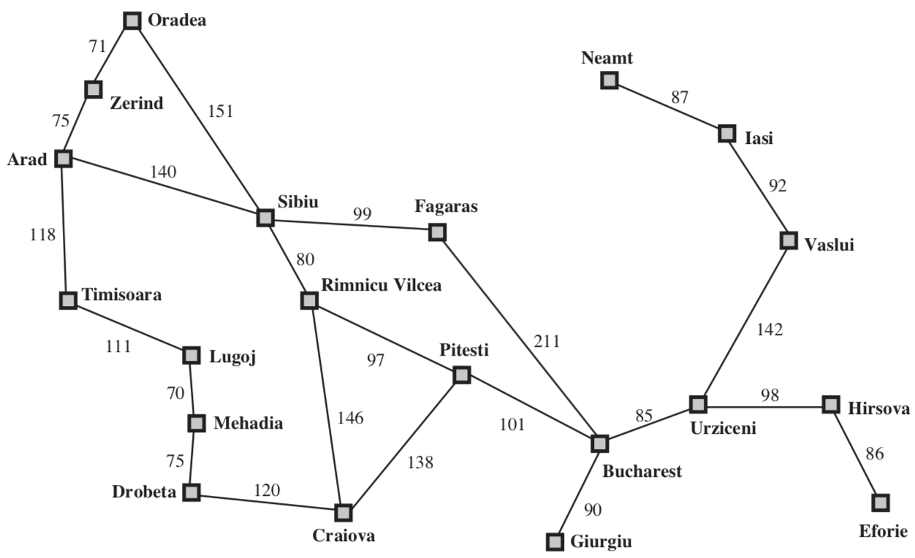
Overview
Uninformed Search
Informed Search
Summary
Overview
Informed search
Use problem-specific knowledge (a “compass”)
Evaluation function $f(n)$
Determine the desirability of node $n$
Search expands node with lowest $f(n)$
Heuristic function $h(n)$
An estimate of cost to get from node $n$ to the goal
With additional knowledge beyond the problem description (e.g., actual distance)

Slide 19
Overview
Uninformed Search
Informed Search
Summary
Greedy Best-First Search
Strategy: expands a node that SEEMS closest to a goal
Evaluation function $f\left(n\right)=h(n)$ (cf. Uniform-cost: $f\left(n\right)=g(n)$)
Priority queue: ordered by a heuristic function
1
not generated
I
$$h(I)=10$$
on frontier
$$h(B)=8$$
2
$$h(G)=6$$
B
G
in memory
deleted
C
G

Slide 20
Overview
Uninformed Search
Informed Search
Summary
Greedy Best-First Search
Strategy: expands a node that SEEMS closest to a goal
Evaluation function $f\left(n\right)=h(n)$ (cf. Uniform-cost: $f\left(n\right)=g(n)$)
Priority queue: ordered by a heuristic function
ex) the straight distance to Bucharest from node $n$
Arad
140
253
Arad
Sibiu
Fagaras
99
176
Sibiu
80
Rimnicu Vilcea
211
$$h(n)=176$$
$$h(n)=193$$
193
97
Fagaras
Rimnicu Vilcea
$h(n)$: straight distance to
Bucharest from city $n$
Pitesti
100
101
Arad | 366
Bucharest | 0
Fagaras | 176
Pitesti | 100
Rimnicu Vilcea | 193
Sibiu | 253
Bucharest
Bucharest
Pitesti
0
Bucharest

Slide 21
Overview
Uninformed Search
Informed Search
Summary
Greedy Best-First Search
Complete?: No (infinite loops)
Optimal?: No
Time complexity: $O(b^{m})$
Space complexity: $O(b^{m})$
Arad
$1$ node
140
Sibiu
$$b$$
99
Fagaras
...
$b$ nodes
80
450
Rimnicu Vilcea
211
$b^{d}$ nodes
97
Pitesti
101
$b^{m}$ nodes
418
Bucharest

Slide 22
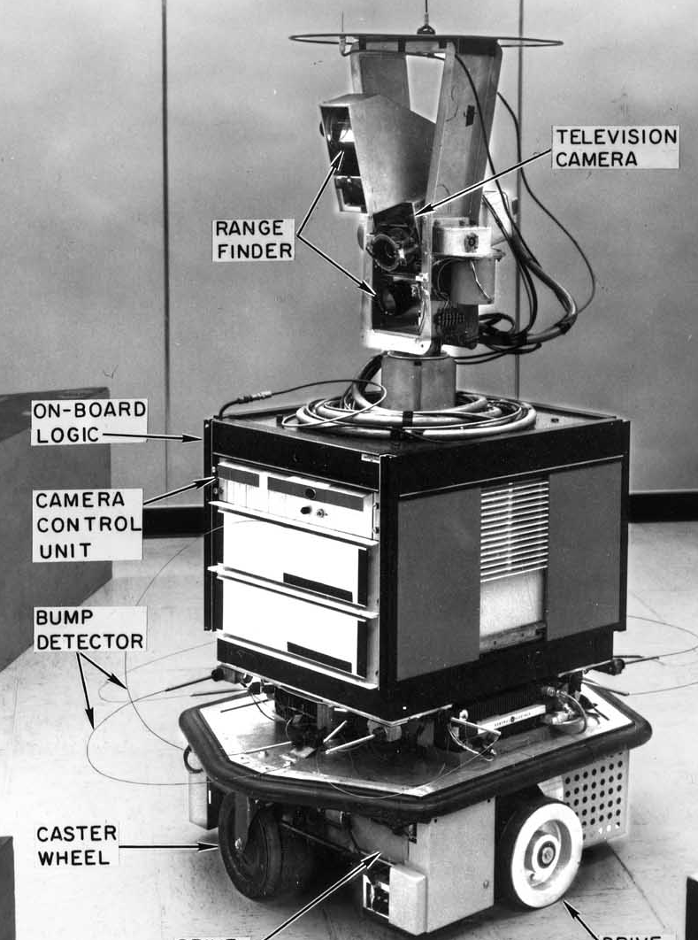
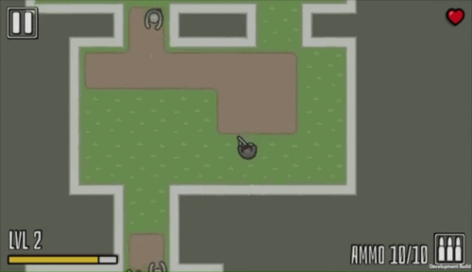
Overview
Uninformed Search
Informed Search
Summary
A* Search
Strategy: Uniform-cost + Best-first
Evaluation function $f\left(n\right)=g\left(n\right)+h\left(n\right)$: cost estimate of the cheapest solution THROUGH node $n$
$g\left(n\right)$: cost to get to node $n$
$h\left(n\right)$: cost (estimate) to get to the goal state from node $n$
A* search for Shakey the Robot (1968)
Reaper of the Undead (2017)
Credit: SRI/ Pixel Packet Studio

Slide 23
Overview
Uninformed Search
Informed Search
Summary
A* Search
Strategy: Uniform-cost + Best-first
Evaluation function $f\left(n\right)=g\left(n\right)+h\left(n\right)$
Arad
140+253=393
Arad
140
239+176=415
140
Sibiu
Sibiu
Fagaras
99
Fagaras
Arad
99
80
80
450
Rimnicu Vilcea
Sibiu
Rimnicu Vilcea
211
211
220+193=413
97
$$f(n)=415$$
$$f(n)=413$$
97
Pitesti
317+100=417
Pitesti
Fagaras
Rimnicu Vilcea
101
101
418
$h(n)$: straight distance to
Bucharest from city $n$
Bucharest
Bucharest
Bucharest
Pitesti
Arad | 366
Bucharest | 0
Fagaras | 176
Pitesti | 100
Rimnicu Vilcea | 193
Sibiu | 253
Bucharest

Slide 24
Overview
Uninformed Search
Informed Search
Summary
Exercise
Draw search trees for Best-first search and A* search
Use the graph search version to avoid redundant paths
Put a number near each node that indicates the order of expansion (not generation)
Some nodes may not have numbers because they were generated, but not expanded.
Goal test: right before expansion
1
A
2
3
B
C
4
5
D
E
Example!

Slide 25
Overview
Uninformed Search
Informed Search
Summary
A* Search
Complete?: Yes (if step cost $≥ε$)
Optimal?: Yes (if $h$ is admissible)
Time complexity: $O(b^{d})$
Space complexity: $O(b^{d})$

Slide 26
Overview
Uninformed Search
Informed Search
Summary
A* Search
Admissible heuristics
A heuristic $h$ is admissible (optimistic) if
$$h\left(n\right)≤h^{∗}(n)$$
where $h^{∗}(n)$ is the true cost to a nearest goal
Never overestimates the cost to reach the goal

Slide 27
Overview
Uninformed Search
Informed Search
Summary
Summary
 | Ordering | Optimal? | Complete? | Efficient?
Depth | LIFO | No | No | If lucky
Breadth | FIFO | Yes (step cost=1) | Yes | No
Uniform | $$g(n)$$ | Yes (step cost $≥ε$) | Yes (step cost $≥ε$) | No
Best | $$h(n)$$ | No | No | Usually
A* | $$g(n)+h(n)$$ | Yes (admissible $h$) | Yes (step cost $≥ε$) | Yes

Slide 28
Overview
Uninformed Search
Informed Search
Summary
Thank you!
Questions?
Web: cs.cmu.edu/~changjon
Email: cjnam@cmu.edu

