Slide 1
Chapter 6 Understanding Each Other
CSE 431 – Intelligent Agents

Slide 2
XML Example
<?xml version="1.0" ?> <cd sernum="99999">
<!-- IMHO, a truly great CD --> <title>Yankee Hotel Foxtrot</title> <artist>Wilco</artist> <cover photo="/covers/yht.gif" /> <track no="4">War on War</track> </cd>

Slide 3
RDF and OWL
World Wide Web Consortium (W3C) Recommendations
RDF(S) (1999, revised 2004)
labeled directed graphs
essentially semantic networks with URIs
XML serialization syntax
OWL (2004)
extends RDF with more semantic primitives
based on description logics (DLs)
has a model theoretic semantics
rdfs:Class
rdf:Property
<owl:Class rdf:ID=”Band”> <rdfs:subClassOf> <owl:Restriction> <owl:onProperty rdf:resource=”#hasMember” /> <owl:allValuesFrom rdf:resource=”#Musician” /> </owl:Restriction> </rdfs:subClassOf> </owl:Class>
A Band is a subset of the groups which only have Musicians as members
rdf:type
rdf:type
rdf:type
g:Person
rdfs:domain
rdfs:subclassOf
u:Chair
g:name
rdf:type
g:name
John Smith

Slide 4
Ontology Header
<!DOCTYPE rdf:RDF [ <!ENTITY owl "http://www.w3.org/2002/07/owl#">]> <rdf:RDF xmlns:owl ="http://www.w3.org/2002/07/owl#" xmlns:rdf ="http://www.w3.org/1999/02/22-rdf-syntax-ns#" xmlns:rdfs="http://www.w3.org/2000/01/rdf-schema#">
<owl:Ontology rdf:about=""> <rdfs:label>My Ontology</rdfs:label> <rdfs:comment>An example ontology</rdfs:comment>
<owl:imports rdf:resource=“http://www.ont.org/generic” /> </owl:Ontology>
...
</rdf:RDF>

Slide 5
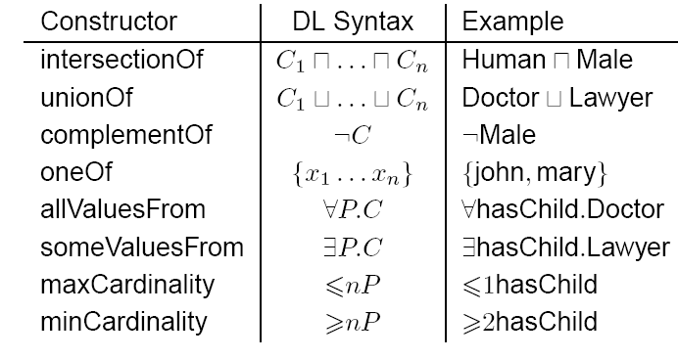
OWL Class Constructors
example taken from Ian Horrocks

Slide 6
Defining Simple Classes
owl:Class
subset of rdfs:Class, excludes “metaclasses”
rdfs:subClassOf
specify formal taxonomies
owl:Thing
set of all individuals
owl:Nothing
empty set of individuals

Slide 7
Defining Properties
two kinds
object properties
relation between two objects
datatype properties
relations between an object and a datatype value
constructors
rdfs:domain
rdfs:range
rdfs:subPropertyOf

Slide 8
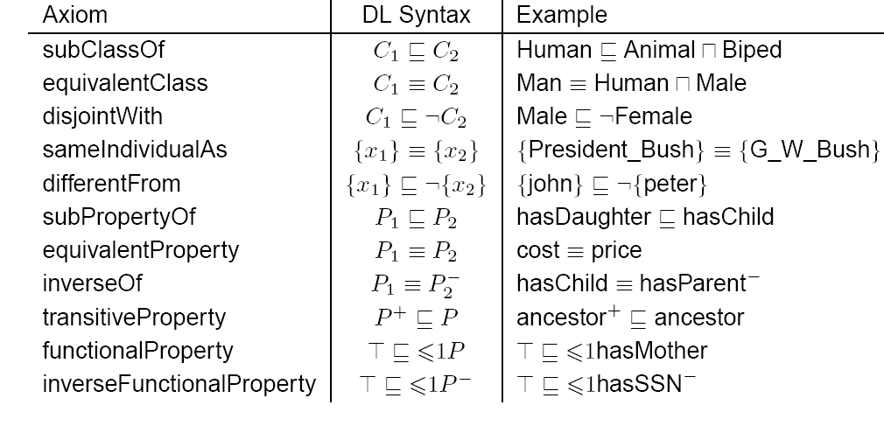
OWL Axioms
example taken from Ian Horrocks

Slide 9
Equality/Inequality
Two URIs refer to the same individual.
<p:Person rdf:about=”http://www.cse.lehigh.edu/~heflin/”> <owl:sameAs rdf:resource=”http://www.cs.umd.edu/~heflin/” /> </p:Person>
Two URIs refer to distinct individuals
<p:Person rdf:about=”http://www.cse.lehigh.edu/~heflin/”> <owl:differentFrom rdf:resource=”mailto:heflin@cse.lehigh.edu” /> </p:Person>

Slide 10
Sets of Distinct Individuals
<owl:AllDifferent> <owl:distinctMembers rdf:parseType=”Collection”> <p:Person rdf:about=”#Bob” /> <p:Person rdf:about=”#Sue” /> <p:Person rdf:about=”#Mary” /> … </owl:distinctMembers> </owl:AllDifferent>
The URIs #Bob, #Sue and #Mary all refer to distinct individuals.

Slide 11
All Values From
<owl:Class rdf:ID=”Band”> <rdfs:subClassOf> <owl:Restriction> <owl:onProperty rdf:resource=”#hasMember”/> <owl:allValuesFrom rdf:resource=”#Musician”/> </owl:Restriction> </rdfs:subClassOf> </owl:Class>
A Band is a subclass of the set of entities which only have members that are Musicians

Slide 12
Some Values From
<owl:Class rdf:ID=”Band”> <rdfs:subClassOf> <owl:Restriction> <owl:onProperty rdf:resource=”#hasMember”/> <owl:someValuesFrom rdf:resource=”#Singer”/> </owl:Restriction> </rdfs:subClassOf> </owl:Class>
Every Band has at least one member who is a Singer

Slide 13
Has Value
<owl:Class rdf:ID=”Guitarist”> <rdfs:subClassOf> <owl:Restriction> <owl:onProperty rdf:resource=”#playsInstrument”/> <owl:hasValue rdf:resource=”#Guitar”/> </owl:Restriction> </rdfs:subClassOf> </owl:Class>
A Guitarist is a subclass of the set of entities which play at least one instrument that is a Guitar.

Slide 14
Minimum Cardinality
<owl:Class rdf:ID=”Parent”> <owl:equivalentClass> <owl:Restriction> <owl:onProperty rdf:resource="#hasChild" /> <owl:minCardinality rdf:datatype= "&xsd;nonNegativeInteger">1</owl:minCardinality> </owl:Restriction> </owl:equivalentClass> </owl:Class>
Parent is exactly the set of entities which have at least one child.

Slide 15
Intersection and Union
<owl:Class rdf:ID=”Father”> <owl:intersectionOf rdf:parseType=”Collection”> <owl:Class rdf:about=”#Parent” /> <owl:Class rdf:about=”#Male” /> </owl:intersectionOf> </owl:Class>
A Father is exactly a Parent who is also Male.
<owl:Class rdf:ID=”Person”> <owl:unionOf rdf:parseType=”Collection”> <owl:Class rdf:about=”#Woman” /> <owl:Class rdf:about=”#Man” /> </owl:unionOf> </owl:Class>
Every Person is Male or Female.

Slide 16
Complement
<owl:Class rdf:ID=”Man”> <owl:intersectionOf rdf:parseType=”Collection”> <owl:Class rdf:about=”#Person” /> <owl:Class> <owl:complementOf rdf:resource=”#Woman” /> </owl:Class> </owl:intersectionOf> </owl:Class>
Man is every Person who is not a Woman.

Slide 17
Disjoint Classes
<owl:Class rdf:ID=”Male”> <owl:disjointWith rdf:resource=”#Female”> </owl:Class>
How is this different from owl:complementOf?
owl:disjointWith does not allow you to conclude that if someone is not Male, then they must be Female
This is a weaker statement than owl:complementOf!

Slide 18
Enumerated Classes
<owl:Class rdf:ID=”PrimaryColor”> <owl:oneOf rdf:parseType=”Collection”> <owl:Thing rdf:about=”#Red” /> <owl:Thing rdf:about=”#Blue” /> <owl:Thing rdf:about=”#Yellow” /> </owl:oneOf> </owl:Class>
PrimaryColor has exactly three instances: Red, Blue and Yellow.

Slide 19
Reasoning with OWL
Consistency checking
Does the ontology contradict itself?
Subsumption
C ⊑ D: is D more general than C?
Concept satisfiability
Is it possible for a concept to have instances?
Classification
What is the proper place of a concept in a taxonomy?

Slide 20
The Semantic Web
Definition
The Semantic Web is not a separate Web but an extension of the current one, in which information is given well-defined meaning, better enabling computers and people to work in cooperation. (Berners-Lee et al., Scientific American, May 2001)
Ontology
a key component of the Semantic Web
ontologies define the semantics of the terms used in semi-structured web pages
identify context, provide shared definitions
has a formal syntax and unambiguous semantics
usually includes a taxonomy, but typically much more
inference algorithms can compute what logically follows

Slide 21
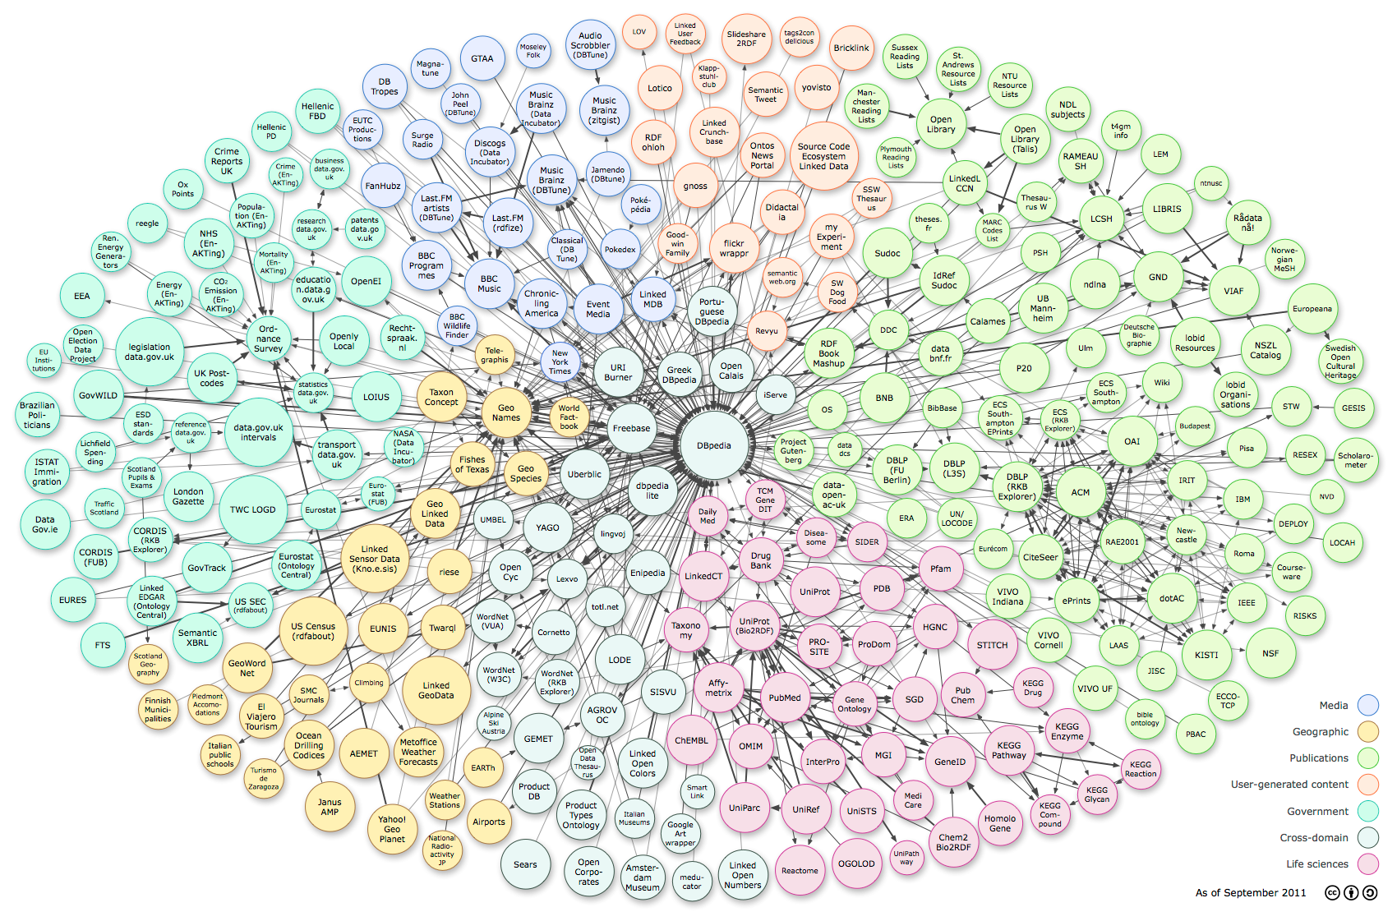
Linked Data
> 149 billion triples of data in over 2800 data sets
Notes:
Figures come from stats.lod2.eu (last access: 9/26/2016)

Slide 22
Level of Adoption?
Open source Semantic Web tools
from IBM, Hewlett-Packard, Nokia, etc.
Commercial software vendors
Oracle 11g RDBMS supports RDF and much of OWL
Adobe’s products use RDF to provide metadata for documents, photos
Semantic Web specific companies: TopQuadrant, Aduna Software, etc.
>400 million Semantic Web documents (as of October 2011)
Yahoo SearchMonkey uses RDF to present richer search results
Google indexes RDFa (a means for embedding RDF in web pages)
Semantic Web enabled sites
Data.gov: much of U.S. government’s open data is available in RDF
Newsweek: annotates articles with RDFa
Library of Congress: modernize the bibliographic environment
BBC Music: exports RDF playlists, RDF for all artists
DBPedia: a Semantic Web version of Wikipedia
BestBuy publishes product and store information in RDF
Notes:
65 million figure comes from Sindice – includes microformats
Oct. 2009: Google finds 463,000 RDF, 30,000 OWL, 51,000 XML with RDF keyword
System Integration costs source: Semantic Technology Conference materials
Other companies:
Boeing: integrate work of partners involved in airplane design
Chevron: manage the life cycle of power plants and oil refineries
British Telecom: online service to help vendors work together
Harper’s Magazine: web site that connects articles to events on a timeline

Slide 23
Ontology Engineering
determine domain and scope
consider reusing existing ontologies
enumerate important terms
define the classes and the class hierarchy
define the properties
define the property restrictions (facets)
create instances
check for anomalies

